Slide 1


Email Marketing - Critical for Your Business
Change this Image (relevant to webinar)
Webinar Title
Webinar Subtitle(1 liner)
Presenter – Instructor Name
Presenter : Rishabh Garg

Slide 2

Know your instructor
He has over 5 years of experience in the Digital Marketing industry. He is currently working with India's leading Online Insurance Aggregator - Policy Bazaar as an Assistant Vice President. Prior to that he has worked with Google India as a Product & Solutions Specialist He has conducted trainings on Email Marketing, Social Media Marketing, Mobile Marketing, Search & Display Marketing, App Marketing for over 2 years.
Rishabh Garg
Assistant VP of Policy Bazaar
Ex Manager at Google
www.edureka.co/email-marketing

Slide 3





What will you learn today?
Let us have a quick poll, do you know the following topics?
Email Marketing Facts & Key Metrics
Email Marketing: Why it should matter to You?
Performance on 3 R’s
Comparison with other Marketing Channels
Role of Email in Sales Process
www.edureka.co/email-marketing

Slide 4
Amazing Facts About Email Marketing

Slide 5
Facts
48%
Percentage of consumers who prefer to communicate with brands via EMAIL
www.edureka.co/email-marketing

Slide 6
Facts
3
times
MORE customers than Twitter and Facebook COMBINED
www.edureka.co/email-marketing

Slide 7

Email Marketing: Why it should matter to You?
Adds value to your sales and service of your business
Email plays a key role in every goal for your organization
Ensures your Business strategy is aligned
Email enables you to test, promote teaser, generate hype

Slide 8
Performance on 3 R’s

Slide 9

Performance on 3 R’s
Reach
Relevance
ROI

Slide 10

Performance on 3 R’s
REACH
4.9 Billion email accounts expected by early 2018
Despite misconceptions that Email is dying, its usage is growing at a rate of 6% per year
90%+ consumers check their email daily
2 out of 3 consumers prefer to have details sent on email
www.edureka.co/email-marketing

Slide 11
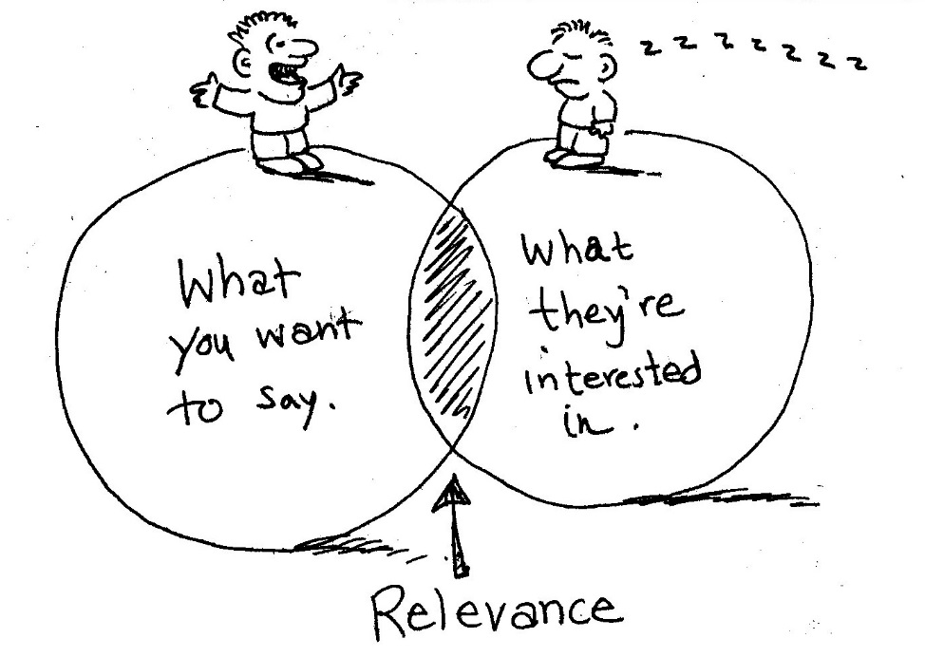
Performance on 3 R’s
RELEVANCE
Relevance = Right Message + Right Time
There are close to 1 Billion mobile email users
An average email user interacts with about 10 Brands
per day on email
Over 50% of users prefer to interact with brands on email
www.edureka.co/email-marketing

Slide 12

Performance on 3 R’s
ROI
Email delivers $40+ of returns for every dollar spent
Revenue from email shot up by 30% in 2014 compared to 2013
Over 40% of email users made at least 1 purchase in 2014 based on the promotional email they received
70%+ companies who used email marketing in 2014 reported it as the ‘Most Economical Channel’
www.edureka.co/email-marketing

Slide 13
Comparison with other Marketing Channels

Slide 14
Customer Engagement with different Channels

Slide 15
Time Spent with Digital Media per day
US Customers 2010-2013 (mins), ages 18-64
Digital Media | 2010 | 2011 | 2012 | 2013
Social Networks | 26 | 30 | 37 | 37
Email | 26 | 28 | 33 | 29
Online Video | 10 | 17 | 24 | 23
Search | 16 | 20 | 22 | 23
Online Games | 13 | 16 | 17 | 19
Blogs | 05 | 06 | 07 | 08
Online Radio | 07 | 06 | 06 | 08
Online Newspapers | 06 | 06 | 06 | 05
Online Magazines | 02 | 03 | 03 | 03
Other Misc | 42 | 44 | 31 | 31
www.edureka.co/email-marketing
Source: IAB ‘2014 Digital Media Study’ conducted with GfK

Slide 16
Industry wise break of Email Volume
Source: www.business2community.com/emailmarketing

Slide 17
Industry wise Performance of Marketing Mails
Industry | Open Rate | Click-Through Rate | Click-To-Open Rate
B2B | 18.7% | 1.5% | 7.8%
Consumer Services | 12.4% | 2.0% | 15.9%
CPG | 18.3% | 2.2% | 12.1%
Entertainment | 19.8% | 2.4% | 12.2%
Financial Services | 28.0% | 1.0% | 3.7%
Healthcare | 17.7% | 3.3% | 18.8%
Hospitality/Travel | 19.7% | 2.1% | 10.6%
Insurance | 31.4% | 7.6% | 24.1%
Advertising | 9.8% | 0.7% | 7.2%
Publishing | 17.5% | 2.9% | 16.7%
Retail/Wholesale | 14.0% | 1.4% | 9.8%
Technology | 20.7% | 1.1% | 5.3%
www.edureka.co/email-marketing
Source: Yesmail ‘Q1 Email Trends and Benchmarks’ Q1, 2014

Slide 18
Email vs. Rest: Numbers Game
Email has thrice the no. of accounts than Facebook and Twitter combined
All web searches made on search engines in a day is equal to 1/100th of daily email traffic
All pages viewed on web in a day use only 1/4th of the bandwidth consumed by email
www.edureka.co/email-marketing

Slide 19
Email vs. Offline: Comparing Measurability
TV
No view for who is watching the Ad
A comparative rating system to evaluate reach
Direct Mail
View of who will receive the mail
No view if the mail has been delivered or read by the receiver
View if the mail has been opened, clicked, which links are working (or not)
View of who will receive the mail
Email
www.edureka.co/email-marketing

Slide 20
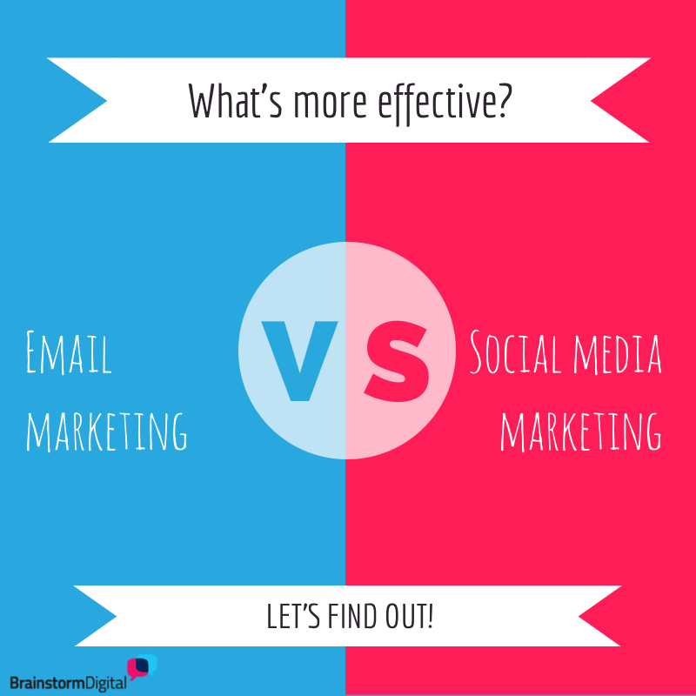
Email vs Social Media Marekting

Slide 21

Email vs. Social Media: Comparing CTRs
Facebook
Avg. CTR on Facebook is 1.49%
Twitter
Avg. CTR on twitter is 1.64%
Email
Avg. CTR on Email is 5.2%
www.edureka.co/email-marketing

Slide 22
Email vs. Rest: Comparing Conversion Rate
Search Engine
Avg. Conv Rate on search engines is 2.50%
Social Media
Avg. Conv Rate on social media is 0.60%
Email
Avg. Conv Rate on Email is 4.25%
www.edureka.co/email-marketing

Slide 23

Email vs. Social Media: Different Purposes
Twitter
Twitter people use to find interesting things and see what the people you follow are saying.
Brands use the medium to engage users in conversations by doing contests and other promotional activities
Facebook
Facebook people use primarily to interact with friends and share their stuff
Brands use the medium to put relevant ads to attract user attention
www.edureka.co/email-marketing

Slide 24
Email vs. Social Media: Different Purposes
Email is much more transactional in nature where a user expects a message from her subscribed website and you can have a 1:1 conversation with a user
In email you can gradually send an appropriate message to a user depending on where the user is in the Sales Lifecycle
Based on Sales Lifecycle
More Transactional
www.edureka.co/email-marketing

Slide 25
Role of Email in Sales Process

Slide 26


Role of Email in Sales Process
Inbound leads captured by your systems are most valuable for your business
There are multiple ways you build on those leads:
Tele Calling
Video Conferencing
Setting up meeting in person
Staying in touch to nurture the lead
www.edureka.co/email-marketing

Slide 27
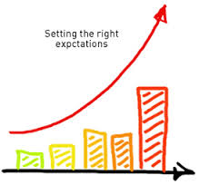
Role of Email in Sales Process
Email is not only one of the ways to build on a lead but also plays an importance in other processes as well
Usual follow up of a Tele Call is sending a mail with quotation or additional information
Before setting up a meeting in person or through VC, you send a mail to set the right expectations so that the meeting is fruitful
Setting the right expectation
Setting Meeting
www.edureka.co/email-marketing

Slide 28

Role of Email in Sales Process
About 80% leads that enter your CRM are not sales qualified and require at least 6 to 10 contacts before converting them into a sale
As a business the more you can maximize on these leads higher will be your profitability as significant amount of resources have gone in to generate those leads
Nurtured leads through emails result in 40% more sales than those that aren’t
www.edureka.co/email-marketing

Slide 29

Certifications
Get Certified in Email Marketing by Edureka
Go to www.edureka.co/email-marketing
Batch starts from 17 October (Weekend Batch)
Time: 8:00PM to 10:00 PM
Edureka's Email Marketing course:
This course will introduce attendees to the world of Email Marketing which Marketers can use to strategize, create, execute and monitor Email Marketing Campaigns successfully.
Online Live Courses: 16 hours
Assignments: 12 hours
Project: 12 hours
Lifetime Access + 24 X 7 Support

Slide 30
Thank You
Questions/Queries/Feedback
Recording and presentation will be made available to you within 24 hours

